Slide 1


FULL STACK WEB DEVELOPMENT WITH DJANGO
Lecture 32

Slide 2

Today’s Agenda
Developing Our Django App
Adding Form Data To The Database
Using Models In View
Final Steps

Slide 3
Adding Form Data To Database
Once we have captured the data filled by the user in our form then our next step is to save it in the database and this can be done in 2 ways:
Using Form and Model classes
OR
Using ModelForms which are specially given for this purpose
We will discuss the first approach here and in next chapter we will discuss the second approach

Slide 4
Steps Needed
Create the Model class
Apply migrations
Create a Form class corresponding to the Model class
Define the View
Generate an Empty Form for the user to fill the data
Capture the form data and validate it
If validation succeeds then create a Model object and initialize it with the validated form data
Save the Model object in the database
Redirect the user to thank you page

Slide 5
Creating Model Class
from django.db import models
class UserModel(models.Model):
userid = models.CharField(max_length=20)
password = models.CharField(max_length=20)
username=models.CharField(max_length=30)

Slide 6
Creating Form Class
from django import forms
class UserRegisterForm(forms.Form):
userid = forms.CharField(label="User Id")
password=forms.CharField(label="Password",widget=forms.PasswordInput)
username=forms.CharField(label="UserName")

Slide 7
Creating The View
from django.shortcuts import render
from registerapp import forms
from registerapp import models
def showRegistrationForm(request):
context={}
if request.method == 'POST':
regform = forms.UserRegisterForm(request.POST)
if regform.is_valid():
uid = regform.cleaned_data["userid"]
pwd=regform.cleaned_data["password"]
uname = regform.cleaned_data['username']
userobj = models.UserModel(userid=uid, password=pwd, username=uname)
userobj.save()
regform=forms.UserRegisterForm()
context['success']='success‘
context[‘username’]=uname
else:
regform = forms.UserRegisterForm()
context['form']=regform
return render(request,'registerapp/showregform.html',context)

Slide 8
Creating The Template
<!DOCTYPE html>
<html lang="en">
<head>
<meta charset="UTF-8">
<meta name="viewport" content="width=device-width, initial-scale=1.0">
<title>Registration Form</title>
<style>
.errorlist{
color: crimson;
list-style-type: none;
margin:0;
padding:0;
}
</style>
</head>

Slide 9
Creating The Template
<body>
{% if form.errors %}
<p style='color: crimson'>
Please correct the following errors!
</p>
{% endif %}
{% if success %}
<p style='color: limegreen'>
Thank you {{ username }} ! for registering with us
</p>
{% endif %}
<h3>Sign Up!</h3>
<form action="" method="POST" novalidate>
{% csrf_token %}
<table>
{{ form }}
</table>
<input type='submit' value='Sign Up' >
</form>
</body>
</html>

Slide 10
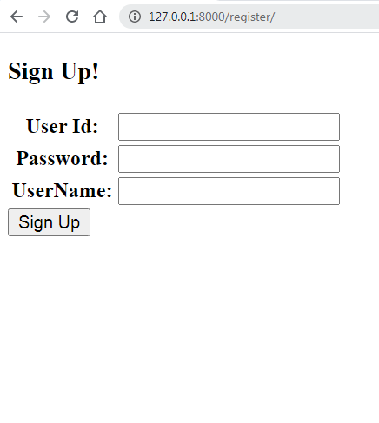
Output

Slide 11
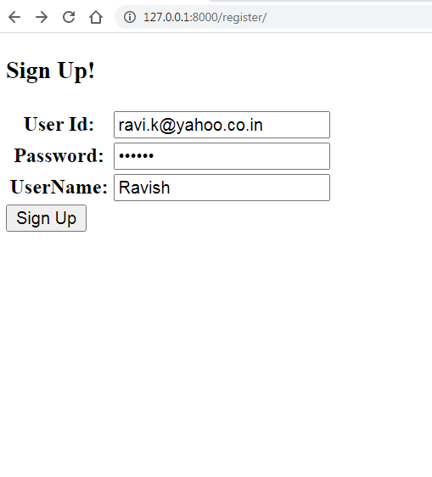
Output

Slide 12
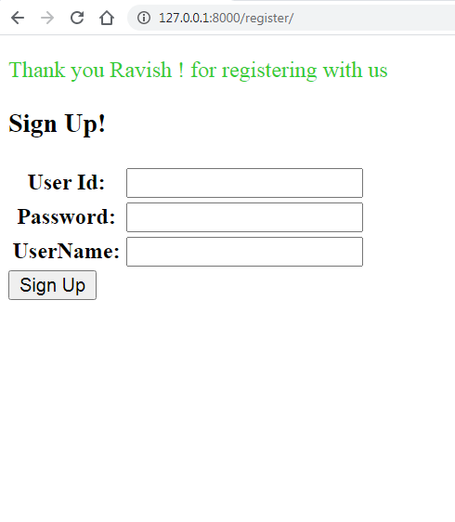
Output

Slide 13
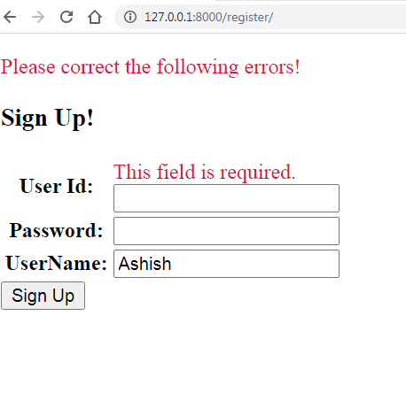
Output

Slide 14
Your Task
Modify the app by doing the following changes :
Add validation rules to userid and password as follows:
Both UserId and Password must be atleast 8 characters long
Userid must contain atleast one uppercase character, one lower case character and one digit .
Password should contain atleast 2 special characters and should not contain UserId in it.
After successful registration allow the user to login
Design the complete login app

